Slide 1
Research Platform for Custom Memory Cube
Yu Zou
Vinayak Deshpande
Peter Harduvel
Dr. Herman Lam
Assoc. Professor of ECE
University of Florida

Slide 2
Outline
Review & overview
Notional CMC architecture
Performance measurements on Merlin board
Mapping notional CMC to Merlin board
Simplified CMC-to-Merlin mapping
Overlapping memory access
Simple read & write ops, DRE ops
Validation of Platform
Validation of PERFMON
Validation of performance measurement
Bloom filter and sorting implementations in HT
Bloom filter demos
Sorting
Going forward
* DRE: Data rearrangement/reordering engine ** CMC Computational Memory Cube

Slide 3
Outline
Review & overview
Notional CMC architecture
Performance measurements on Merlin board
Mapping notional CMC to Merlin board
Simplified CMC-to-Merlin mapping
Overlapping memory access
Simple read & write ops, DRE ops
Validation of Platform
Validation of PERFMON
Validation of performance measurement
Bloom filter and sorting implementations in HT
Bloom filter demos
Sorting
Going forward
* DRE: Data rearrangement/reordering engine ** CMC Computational Memory Cube

Slide 4
Notional CMC Architecture*
Based on Nair et al.* : an HMC with a user-programmable logic layer
A, B, C, D, and : performance-measurement points of interest
* Nair, R., et al. "Active Memory Cube: A processing-in-memory architecture for exascale systems.“ IBM Journal of Res. & Development 59.2/3 (2015): 17-1.

Slide 5
DRE* Prototype on CMC Architecture
VB3
VB2
VB3
VB1
View buffer (VB) can be set up on host (design option 1), inside the HMC (design option 2) or inside CMC logic (design option 3)
* DRE: Data Reordering/Rearrangement Engine Lawrence Livermore Nat. Labs

Slide 6
Performance Measurement on Merlin Board
CMC platform on Merlin board
*
Instrumented Merlin infrastructure with hardware performance monitors
A’, B’, C’, D’, M1, M2, M3, M4, M5, and E’
Progress: Able to measure all listed parameters except:
M4, M5: Exploring with help from Convey
E’: Exploring with help with Micron under NDA
VB*: View Buffer

Slide 7
Mapping Notional CMC onto Merlin Board
Merlin board
Case study: model of a notional CMC
Simplifying assumption:
For this model, this part of CMC is assumed to have an HMC architecture

Slide 8
Model of CMC-to-Merlin Mapping
Model of notional CMC
CMC platform on Merlin board
Latency A = ctrl signal transfer time B + latency C + result transfer time B
Ctrl signal transfer time B : time to transfer control signals between host and CMC
Data transfer time B: time for host access to obtain result (e.g., transfer from view buffer)
Latency C = delay TSV* + latency C’ – delay D’minusE’
Delay D’minusE’ = latency D’ – latency E’
* delay TSV= between DRE core and switch, time to transfer a request +
time to transfer response of that request
Latency: round-trip delay from input into a point in the system to desired outcome

Slide 9
Outline
Review & overview
Notional CMC architecture
Performance measurements on Merlin board
Mapping notional CMC to Merlin board
Simplified CMC-to-Merlin mapping
Overlapping memory access
Simple read & write ops, DRE ops
Validation of Platform
Validation of PERFMON
Validation of performance measurement
Bloom filter and sorting implementations in HT
Bloom filter demos
Sorting
Going forward
* DRE: Data rearrangement/reordering engine ** CMC Computational Memory Cube

Slide 10
Overlapping Memory Access: read/write ops
Observation: M1, M2, M3, (M4, M5, E’) have no significant difference

Slide 11
Overlapping Memory Access: DRE ops
Observation: M1, M2, M3, (M4, M5, E’) again have no significant difference
For overlapping memory access, discrepancy between M1, M2, M3, (M4, M5, E’) is hidden by “pipeline effect”
Thus, a simplified CMC mapping can be used

Slide 12
Simplified Notional CMC Modeling
For pipelined overlapping memory operations, estimate:
M1 = M2 = M3 = M4 = M5 = E’
Model of notional CMC
CMC platform on Merlin board
Latency A = ctrl signal transfer time B + latency C + result transfer time B
Ctrl signal transfer time B : time to transfer control signals between host and CMC
Data transfer time B: time for host access to obtain result (e.g., transfer from view buffer)
Latency C = latency C’ – delay D’minusE’ + delay TSV*
Delay D’minusE’ = latency D’ – latency E’
Latency: round-trip delay from input into a point in the system to desired outcome

Slide 13
Simplified Notional CMC Modeling
For pipelined overlapping memory operations, estimate:
M1 = M2 = M3 = M4 = M5 = E’
Model of notional CMC
CMC platform on Merlin board
Latency A = ctrl signal transfer time B + latency C + result transfer time B
Ctrl signal transfer time B : time to transfer control signals between host and CMC
Data transfer time B: time for host access to obtain result (e.g., transfer from view buffer)
Latency C = latency C’ + delay TSV*
Latency: round-trip delay from input into a point in the system to desired outcome

Slide 14
Outline
Review & overview
Notional CMC architecture
Performance measurements on Merlin board
Mapping notional CMC to Merlin board
Simplified CMC-to-Merlin mapping
Overlapping memory access
Simple read & write ops, DRE ops
Validation of Platform
Validation of performance measurement
Validation of PERFMON
Bloom filter and sorting implementations in HT
Bloom filter demos
Sorting
Going forward
* DRE: Data rearrangement/reordering engine ** CMC Computational Memory Cube

Slide 15
Validation of Measurement
Goal: validate performance measurement on Merlin board
Approach: Merlin board from Convey and HMC SystemC simulator from Micron
Measurement on Merlin board
Simulation on HMC Simulator

Slide 16
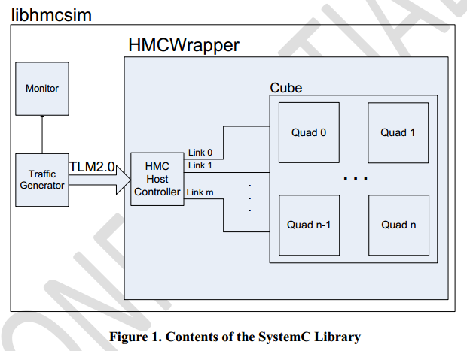
HMC SytemC Simulator - Architecture
Cycle-accurate simulator
by Micron
Main modules:
Synthetic traffic generator
Host controller
HMCWrapper
Monitor
Host Controller
Map requests to links
Create formatted packets (places
in corresponding request buffer)
Micron Technology, Inc., HMC SystemC Model
Document Revision 1.0 (SVN R194)

Slide 17
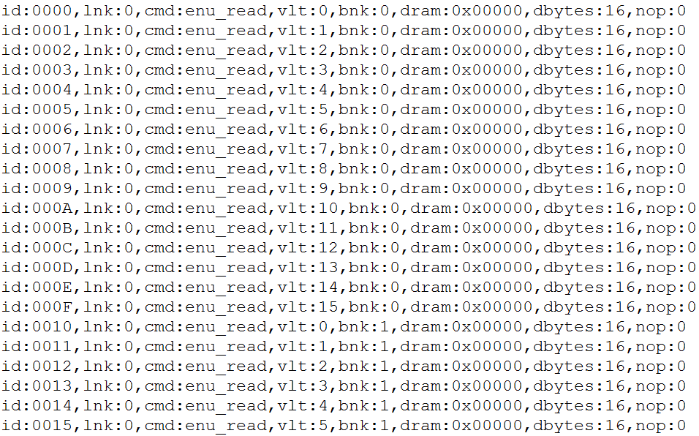
Generated Trace File – For Simulator

Slide 18
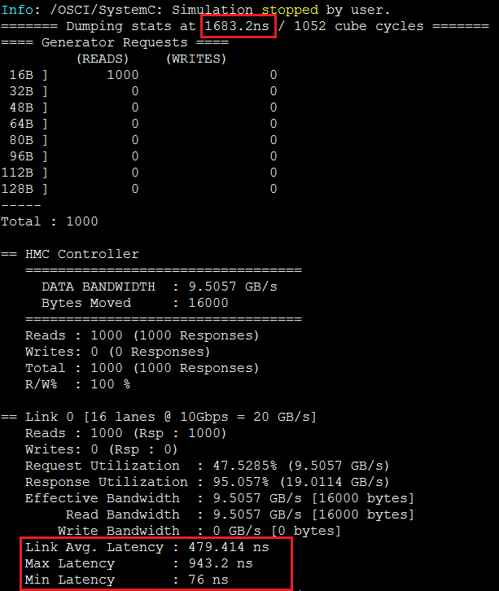
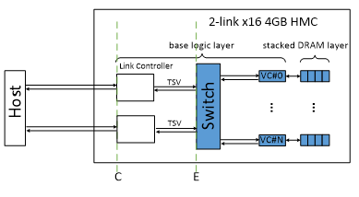
Example Output
The bandwidth and latency calculations are measured on the pins of the HMC (C point in nontional CMC architecture)

Slide 19
Validation of Measurement
Measurement on Merlin board
overlapping memory request:
Measured on Merlin board: D’=M1=M2=M3
Hypothesis: M3 = M5 (= E’)
Collect memory trace at D’
Input memory trace to simulator’s host
Expect: M1 = M5 (= E’) = C = E (from HMC simulator)
Simulation on HMC Simulator

Slide 20
Validation of Measurement
Progress

Slide 21
Validation of PERFMON
M1, M2, M3 are measured in PERFMON
PERFMON – Hardware(Verilog) monitor designed by Convey, modified by CHREC
M4, M5, E’ are not measured
By observing M1 = M2 = M3, we hypothesize M1 = M2 = M3 = M4 = M5 = E’
To validate M1, M2, M3 are accurately measured in PERFMON

Slide 22
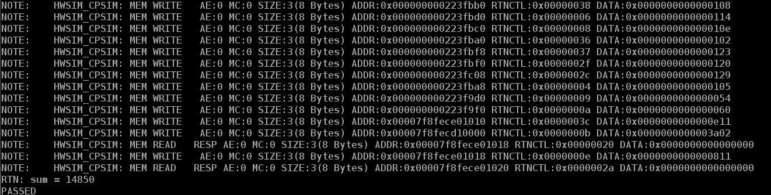
Validation of PERFMON
Progress
Set up a RTL simulation of PERFMON in ModelSim, with help from Convey
Validating the reported PERFMON values cycle by cycle in ModelSim

Slide 23
Outline
Review & overview
Notional CMC architecture
Performance measurements on Merlin board
Mapping notional CMC to Merlin board
Simplified CMC-to-Merlin mapping
Overlapping memory access
Simple read & write ops, DRE ops
Validation of Platform
Validation of PERFMON
Validation of performance measurement
Bloom filter and sorting implementations in HT
Bloom filter demos
Sorting
Going forward
* DRE: Data rearrangement/reordering engine ** CMC Computational Memory Cube

Slide 24
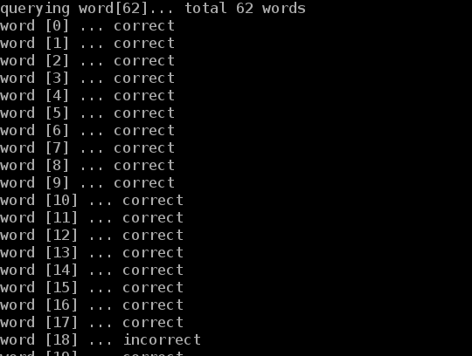
Bloom Filter HT Demos
Spell checker
Used a dictionary as database to set bit vector
When a new word comes, bloom filter searches the existence of word in dictionary
Report the word is wrongly spelled, if it doesn’t exist in dictionary
Utilized 1 HT unit

Slide 25
Bloom Filter HT Demos
Content-based deep packet inspection (longest string match)
Used a group of different-length sensitive words to set bit vectors
When a packet comes, bloom filter searches the existence of the longest matching sensitive word
Report the packet contains sensitive information, if matched
Utilized 16 HT unit

Slide 26
Sorting

Slide 27
Outline
Review & overview
Notional CMC architecture
Performance measurements on Merlin board
Mapping notional CMC to Merlin board
Simplified CMC-to-Merlin mapping
Overlapping memory access
Simple read & write ops, DRE ops
Validation of Platform
Validation of PERFMON
Validation of performance measurement
Bloom filter and sorting implementations in HT
Bloom filter demos
Sorting
Going forward
* DRE: Data rearrangement/reordering engine ** CMC Computational Memory Cube

Slide 28
Going Forward
F1
Platform development
Complete validation of CMC platform
Complete development & instrumentation of CMC platform
Develop library for customization of notional CMC architecture under study
Create user-friendly CMC API
Explore CMC apps using HT
Case studies to explore
Notional CMC architectures
CMC apps, including:
Data Reordering/Rearrangement Engine, sorting algorithms, bloom filter
Lessons learned, including:
Characteristics of CMC-amenable apps
How to re-factor algorithms to become CMC-amenable
Share code and lessons with LPS
Visit LPS

